Slide 1
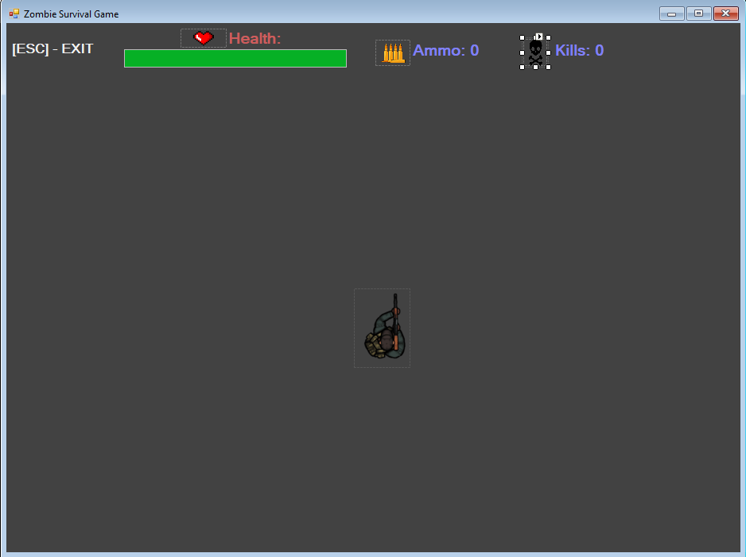
Control Type: Label
Name: lblExit
Function: Purely informational label for the user so that they know they can exit the game by clicking Escape
Control Type: Label
Name: lblKills
Function: Updated to show player score, for the user to know how many kills they have
Control Type: PictureBox
Names: pboLabelHealth, pboLabelAmmo, pboLabelKills
Function: Icons representing each label
Control Type: Label
Name: lblAmmo
Function: Updated to show ammunition count, informational label for the user to see
Control Type: Label
Name: lblHealth
Function: Informational label showing that health bar is on the right
Control Type: Progress Bar
Name: prgHealthBar
Function: Shows remaining health using a graphical , coloured health bar
Control Type: Form
Name: frmGame
Function: Grey background colour so that other labels and sprites can be seen clearly. This form holds everything and can be maximised by the user
Control Type: PictureBox
Name: pboPlayer
Function: This is the player’s character, it is made as a picture box from the start so that it can be updated easily

Slide 2

Control Type: Timer
Name: tmrGameTimer
Function: Built in timer taken from forms that automatically ticks and completes certain tasks with each tick.

Slide 3
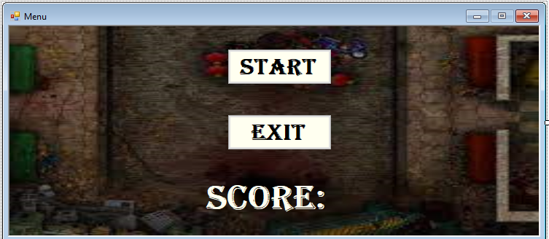
Control Type: Form
Name: frmMenu
Function: Has a background image of the actual gameplay, found in resources. This window can also be resized.
Control Type: Button
Name: btnStart
Function: The user can click this button to start the game. The form will then close and gameplay will start.
Control Type: Button
Name: btnExit
Function: The user can click this button to exit the menu, and game as a whole. This is a usability feature that allows the user to exit the game easily.
Control Type: Label
Name: lblScore
Function: Informational label showing the previous score, will be empty when the game is first ran, and will show the previous round’s score when the player dies

